Slide 1
Object Oriented Programming
Lecture-02

Slide 2
Lecture Content
Lecture Contents
1. Information Hiding
2. Encapsulation
3. Interface
4. Abstraction
5.Classes
6. Inheritance

Slide 3
Information Hiding:
Information hiding is one of the most important principles of OOP inspired from real life which says that all information should not be accessible to all persons.
Private information should only be accessible to its owner.
By Information Hiding we mean “Showing only those details to the outside world which are necessary for the outside world and hiding all other details from the outside world.”

Slide 4
Real Life Examples of Information Hiding
Ali’s name and other personal information is stored in his brain we can’t access this information directly. For getting this information we need to ask Ali about it and it will be up to Ali how much details he would like to share with us.
An email server may have account information of millions of people but it will share only our account information with us if we request it to send anyone else accounts information our request will be refused.

Slide 5
Information Hiding
The perspective of Object Oriented Programming Information Hiding is,
“Hiding the object details (state and behavior) from the users”.
All information related to an object is stored within the object
It is hidden from the outside world
It can only be manipulated by the object itself
We can achieve information hiding using Encapsulation and Abstraction.

Slide 6
Encapsulation
Encapsulation means “we have enclosed all the characteristics of an object in the object itself”.
Encapsulation and information hiding are much related concepts (information hiding is achieved using Encapsulation).
We have seen in previous lecture that object characteristics include data member and behavior of the object in the form of functions.
Data and Behavior are tightly coupled inside an object and both the information structure and implementation details of its operations are hidden from the outer world.

Slide 7
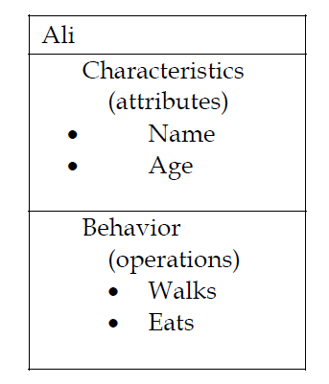
Examples of Encapsulation

Slide 8
Advantages of Encapsulation
Simplicity and clarity
Low Complexity
Better Understanding

Slide 9
Interface
Interface is a set of functions of an object that he wants to expose to other objects.
We discussed previously that data and behavior of each object is hidden in that object it self so we have to use the concept of interface of the object to expose its behavior to outer word objects.
Each object provides interface/s (operations) to other objects through these interfaces other objects communicate with this object.

Slide 10
Example – Interface of a Car
Steer Wheels
Accelerate
Change Gear
Apply Brakes
Turn Lights On/Off

Slide 11
Example – Interface of a Phone
Input Number
Place Call
Disconnect Call
Add number to address book
Remove number
Update number

Slide 12
Abstraction
Real life objects have a lot of attributes and many kind of behaviors but most of the time we are interested in only that part of the objects that is related to the problem we are currently going to solve.
Example: In implementing a school system we don’t need to take care of the personnel life of a student or a teacher as it will not effect our system in any way so we will see these objects in the perspective of school system and will ignore their other characteristics, this concept is called “Abstraction”.

Slide 13
Abstraction
Principle of abstraction:
“Capture only those details about an object that are relevant to current perspective”.
Abstraction is a way to cope with complexity and it is used to simplify things.

Slide 14
Abstraction Example:
Suppose we want to implement abstraction for the following statement,
“Ali is a PhD student and teaches BS students”
Here object Ali has two perspectives one is his student perspective and second is his teacher perspective.

Slide 15
Abstraction Example:
We can sum up Ali’s attributes as follows,
Name
Age
Student Roll No
Year of Study
CGPA
Employee ID
Designation
Salary
As you can see out of all these listed attributes some belong to Ali’s student perspective(Roll No, CGPA, Year of study) and some belong to Ali’s teacher perspective(Employee ID, Designation, Salary).

Slide 16
Abstraction Example:
Behavior of Ali is as Follow:
Study
DevelopExam
GiveExam
TakeExam
PlaySports
Eat
DeliverLecture
Walk

Slide 17
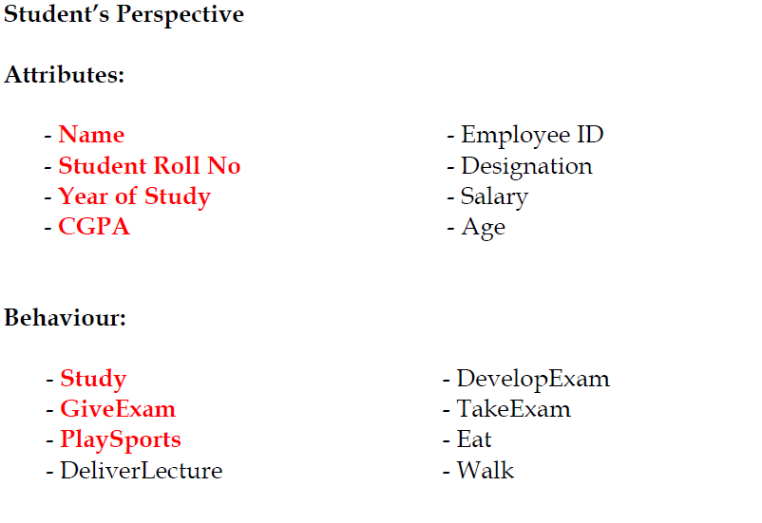
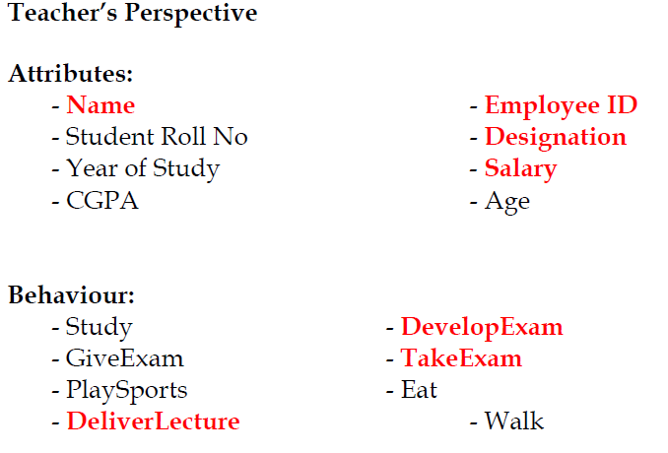

Slide 18
Classes
In OOP we create a general sketch for each kind of objects and then we create different instances using this sketch we call this sketch or prototype or map as “class”.
All objects of same kind exhibit identical characteristics (information structure and behavior) however they have data of their own.
Class provide the description about the object or we can say that all common characteristics( attribute+behaviour) will be the part of a Class.

Slide 19
Example1: Classes
Consider the objects given below,
Ali studies mathematics
Anam studies physics
Sohail studies chemistry
Each one is a Student so we say these objects are instances of the Student class.

Slide 20
Class –Example 2
Ahsan teaches mathematics
Aamir teaches computer science
Atif teaches physics
Each one is a teacher so we say these objects are instances of the Teacher class

Slide 21
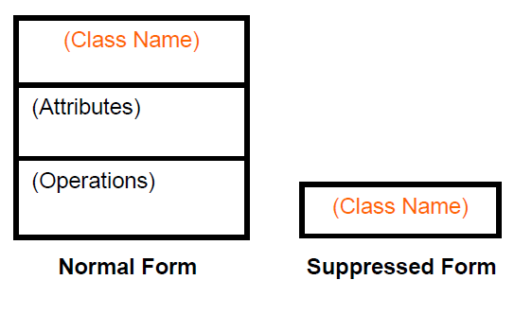
Class Representation

Slide 22
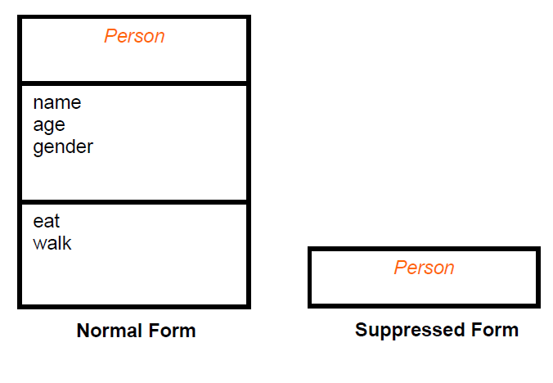
Class Representation

Slide 23
Inheritance
A child inherits characteristics of its parents, besides inherited characteristics, a child may have its own unique characteristics.

Slide 24
Inheritance in Classes
If a class B inherits from class A then it contains all the characteristics (information structure and behaviour) of class A
The parent class is called base class and the child class is called derived class Besides inherited characteristics, derived class may have its own unique characteristics

Slide 25
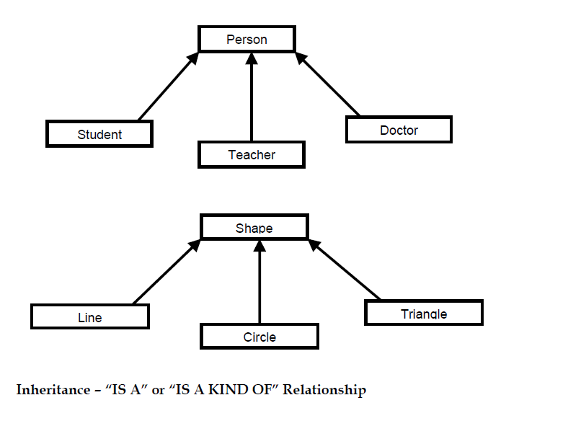

Slide 26
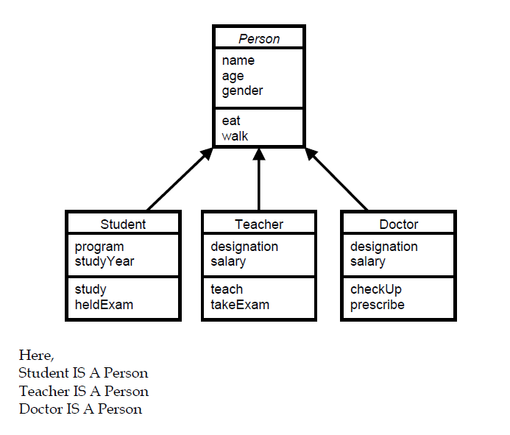

Slide 27
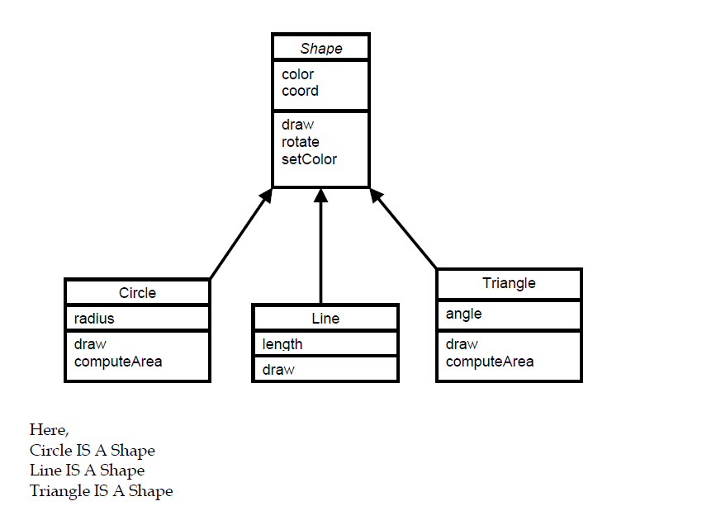

Slide 28
Inheritance – Advantages
Reuse
Less redundancy
Increased maintainability

